Slide 1
Nesflis & Co.
What is the best streaming service to get?
Gabby Olivares
Leonardo Alvarado
Edwin Rosales
Rodrigo Lozano

Slide 2






Notes:
Motivation: its the weekend, you want to watch some tv and relax.
You’ve heard from your friends about great movies on different platforms.
You have not subscribed to any platform, so you are fairly new to this new streaming phenomenon.
But…
Which one should you choose?
Should you blindly follow your friends’ advice?
What are your own movie watching preferences?
What is your favorite genre?
Do you have kids and want age-appropriate content?

Slide 3

Motivation & Core Message
Motivation: Our questions
How can I decide between platforms?
What are the differences among them?
Which is better?
Which streaming service should I choose?
Hypothesis
IF all the streaming platforms are the same THEN it doesn’t matter which one you choose
IF all the streaming platforms are different THEN it does matter which one you choose
Core Message and Big Idea
There are so many streaming platforms out there, making it hard to choose which one to subscribe to.
We believe that different platforms are better according certain user preferences.

Slide 4
Summary
One minute Story
We believe that we were able to answer our questions with some surprising results:
Even though platforms have more movies in their collection, one could question their overall quality.
Movie rating is not necessarily determined by the country the movie is from or the year it was released.
Genres have different quality distributions depending on what platform we’re looking at.
Platforms make emphasis in having large amounts of particular movie genres in their collections.
Notes:
Bottom line...

Slide 5


Questions & Data
From what was said before, final questions came up:
How many movies are there in each platform?
How is the IMDb movie score distributed in all the platforms?
Which is the top rated movie of all times by users?
From which countries and services does the top 5 movies come?
Which is the oldest and newest movies ranked the best, by users?
Which is the best platform by genre? Both, by quantity and quality
Genres in Unique content: who has what?
What is the platform with +unique content of your fav genre?
Since day 1, we brought different project opportunities.
But was the Movie IMDb the one that started a with a very interesting discussion, How each one of us selected our streaming service? Which one do we prefer? And Why?
Our curiosity first took us to look up at the web for different IMDb links, among other.
https://rapidapi.com/Streamzui/api/streamzui-amazon-prime-video-search
https://public-apis.xyz/collection/top-10-movie-apis-to-getting-started
https://www.imdb.com/
Finally we decided to use csv Kaggle collection, based on availability, Data distribution and the fact that provide the most complete Data Base found, as in size and data challenge.
https://www.kaggle.com/ruchi798/movies-on-netflix-prime-video-hulu-and-disney

Slide 6

Clean Up
& Exploration
Notes:
Summary:
Initial Clean Up and exploration process: On Jupyter Notebooks we started by dropping columns not useful or with incomplete information or NaN values...
First we dropped the RT, Directors, Type and Unamed:0 from the df.
RT and Directors don’t really help with our specific analysis and Unamed and Type we’re basically useless.

Slide 7
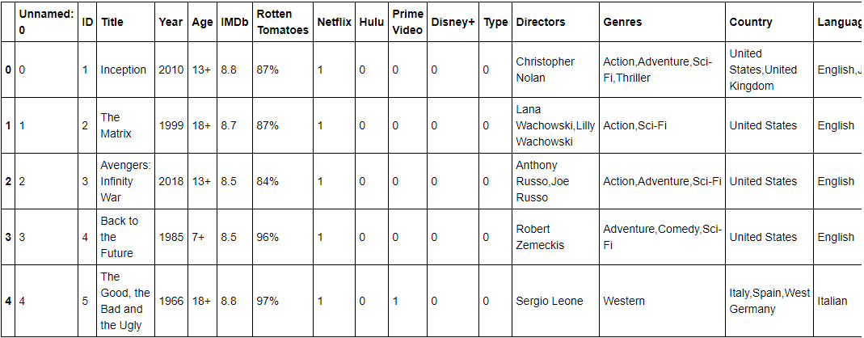
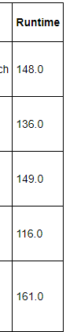
Clean up & Exploration:
To answer our questions, we used a CSV available in Kaggle:
It looks like this:

Slide 8
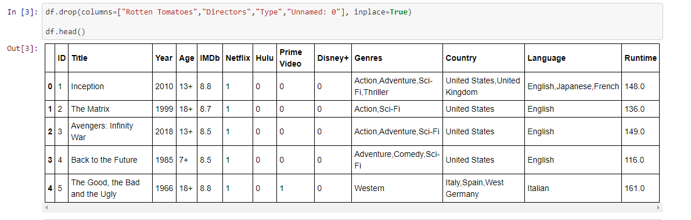
Data Cleaning
first...
then...
Notes:
First we dropped the RT, Directors, Type and Unamed:0 from the df.
RT and Directors don’t really help with our specific analysis and Unamed and Type we’re basically useless.

Slide 9
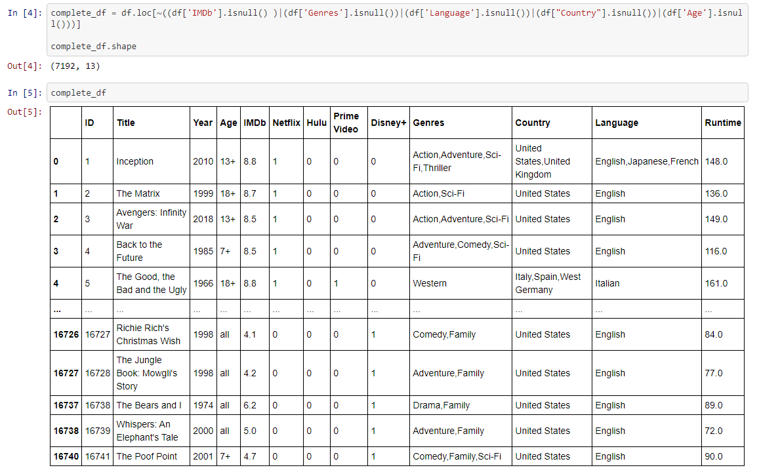
Notes:
We wanted to have the most complete data that we could have, so we used the NOT operator (~) to find all the rows that had no null values

Slide 10
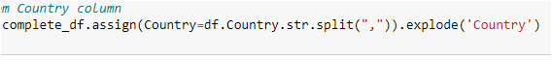
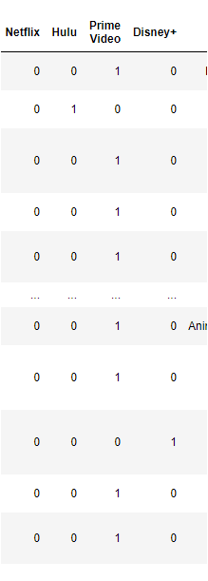
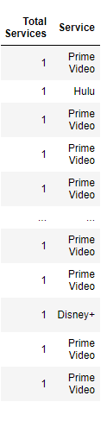
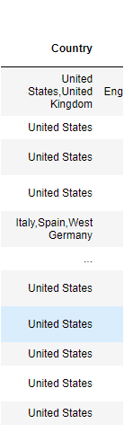
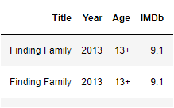
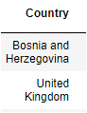
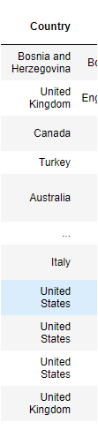
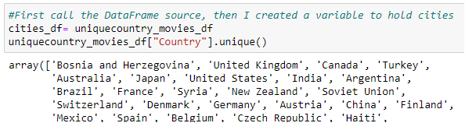
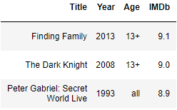
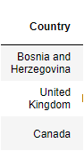
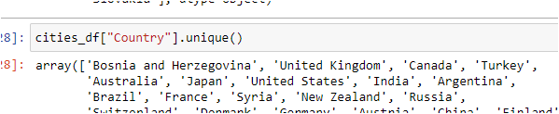
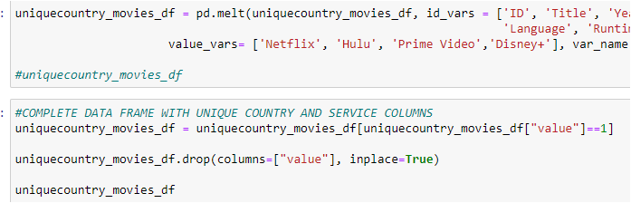
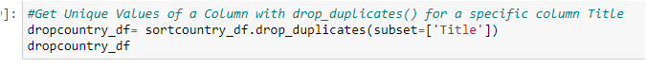
Exploration & Cleaning:
Geocoding and Mapping. 4 Main steps
Country split
Drop duplicates and NaN
Merge Services in 1 column
Standardizing and replacing with updated names for Gmaps reading
Before
After
Before
After
Before
Before
After
After

Slide 11
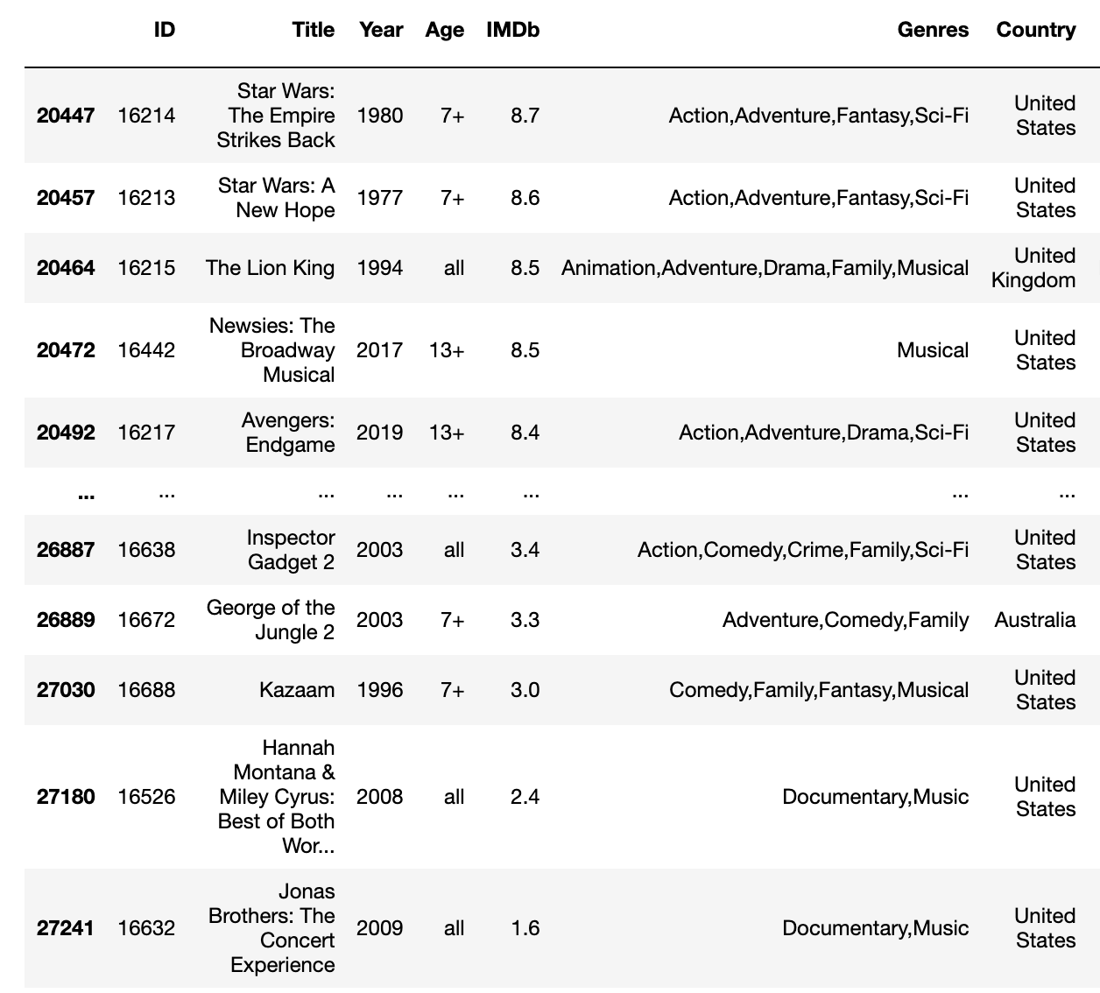
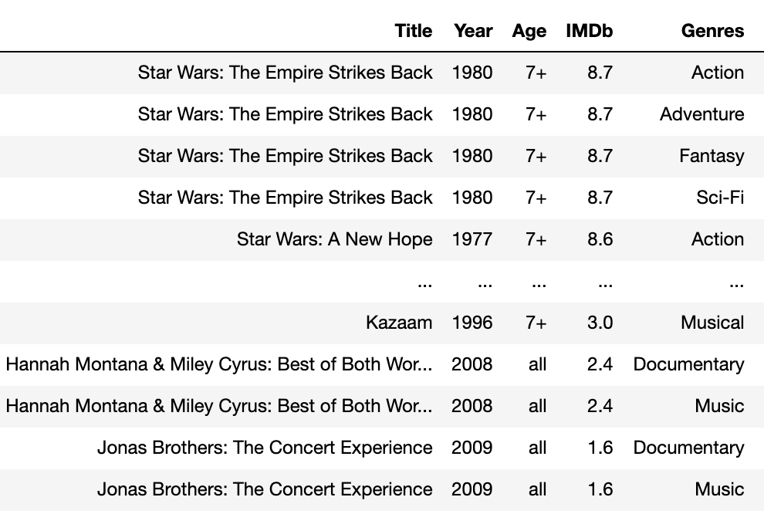
Exploration & Cleaning:
Separating columns by Genre
In order to analyze our we had to split the genres that were on the same column, to split in several rows.
Before
After

Slide 12

Data
Analysis
&
Process
Notes:
Summary:
The IMDb offers a rating scale that allows users to rate films on a scale of one to ten. Our selected Data Base provide us information not only to evaluate the movies ratings from all times, but also to debug about the streaming service, platforms, movie genres, country and year filming.

Slide 13
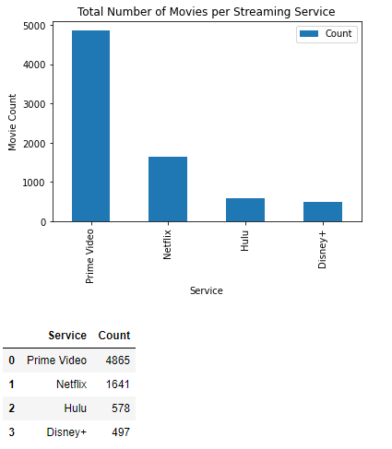
Question:
How many movies are there in total for each platform.
How is the IMDb movie score distributed in all the platforms?
Before we go into the movie scores, let’s first see how many movies each platform has in total.
As we can see on the graph, Amazon Prime has the selection of movies out of all the platforms.
However, quantity is not always equal to quality...

Slide 14
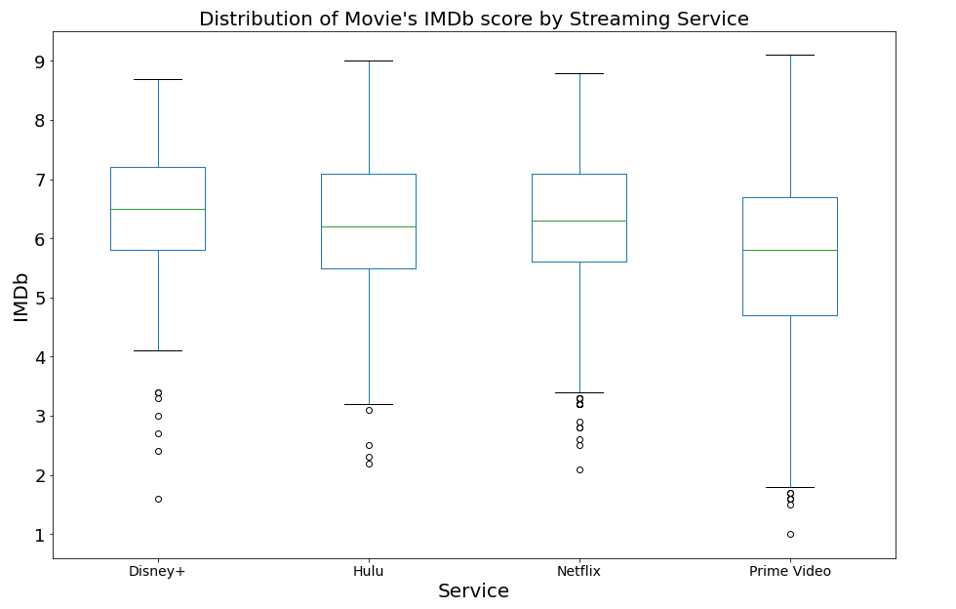
Because quantity =/= to quality, now we can investigate how IMDb scores are distributed along the movies of each platform.
We can see on this new graph, that Disney+ and Netflix have a better IMDb score distribution than the rest of the streaming services.
Even if Disney+ has the lowest selection of movies in their collection, as we saw before, they have top-rated movies in their collection.

Slide 15
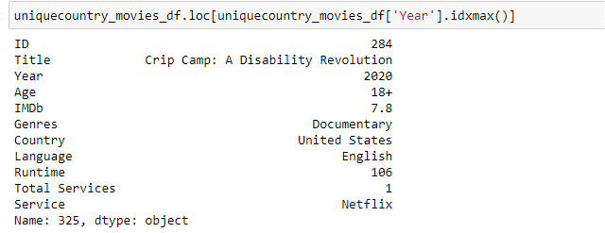
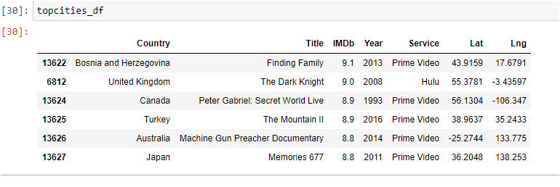
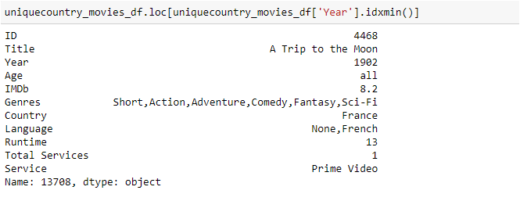
Questions:
1.Which is the top rated movie of all times by users?
2.From which countries and services does the top 5 movies come?
3.Which is the oldest and newest movies ranked the best, by users?
The Top rated movie of all times by users is: Finding Family, a history documental from 2013 based on a true 56 minutes story of Alex Chivescu, from Bosnia. https://www.hallmarkmoviesandmysteries.com/finding-a-family/about
The Top 5 movies from all times are from: Bosnia, UK, Canada, Turkey, Australia and Japan
As well as the majority came from Prime Video streaming service
Insight: Users rating is not related or determined by the country of origin nor if it is a new or old movie; but other attributes.
And what about the oldest and newest movies ranked the best? Well, based on the releasing Year, the recent movie ranked the best is...
And the best oldie is…..

Slide 16
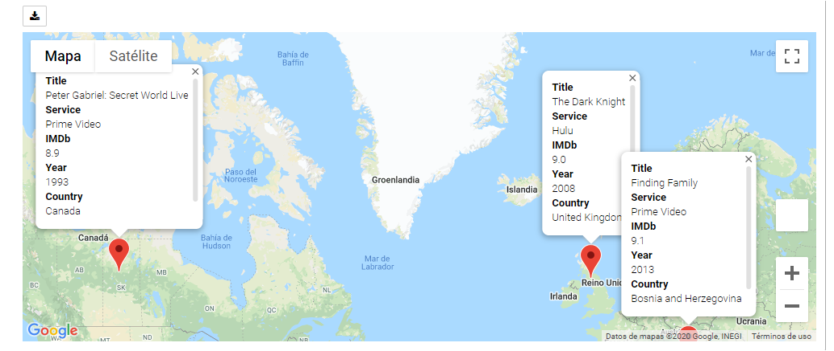

Mapping the IMDb Top 5 movies of all times...
Finally , by calling an API to use gmaps, cleaning up and replacing country names, setting the Top 5 unique countries to be mapped, geocoding and defining marker titles we were able to map our best movies ever!!!...

Slide 17
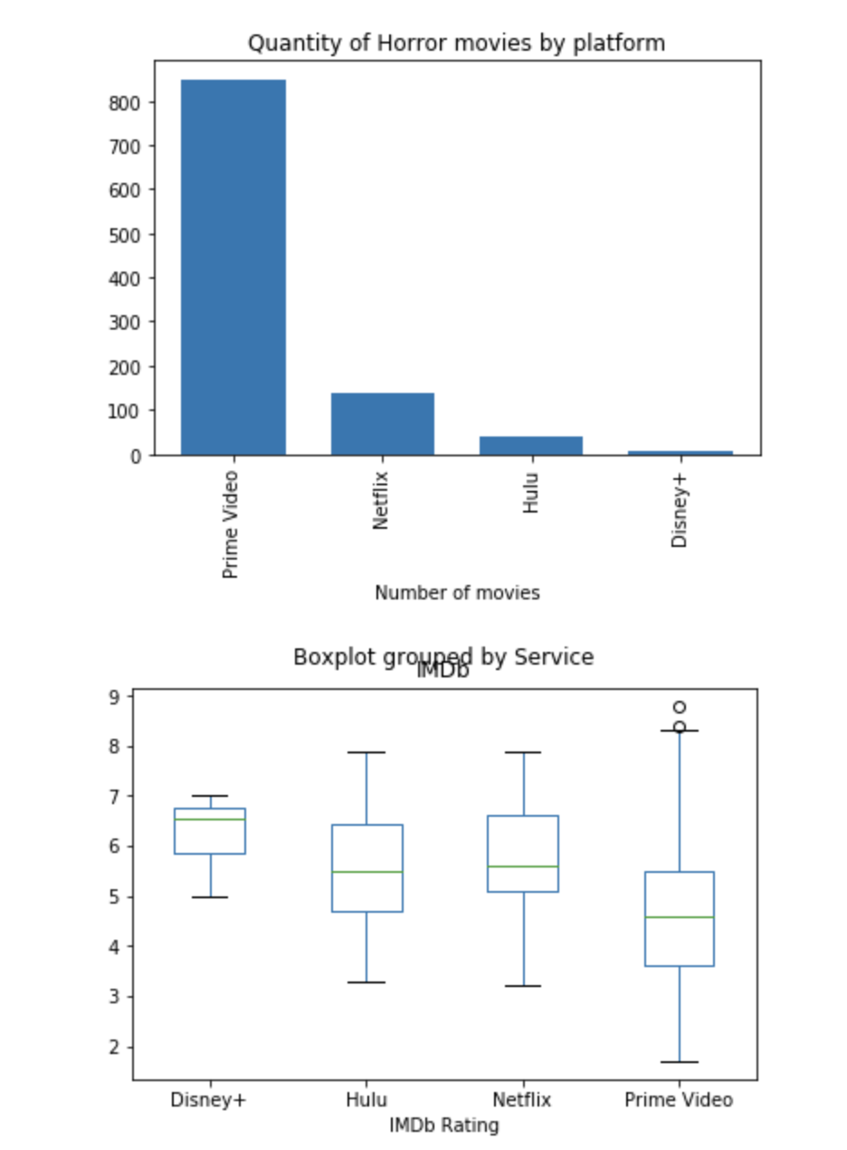

Question:
Which is the best platform for Horror Movies?
For Horror movie fans Prime has the largest number of movies, but Disney + has the best rating

Slide 18
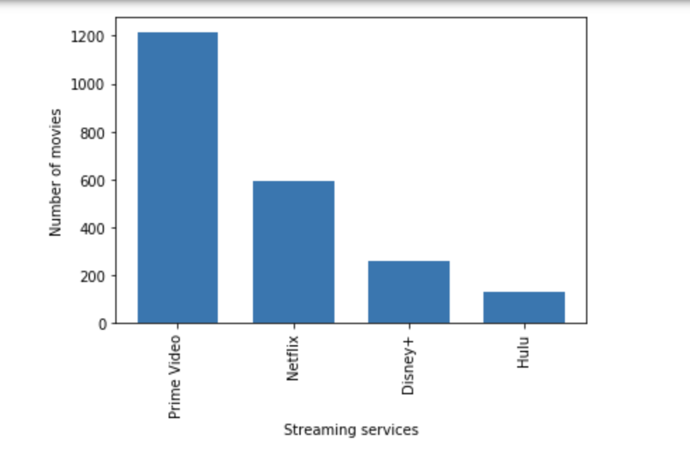

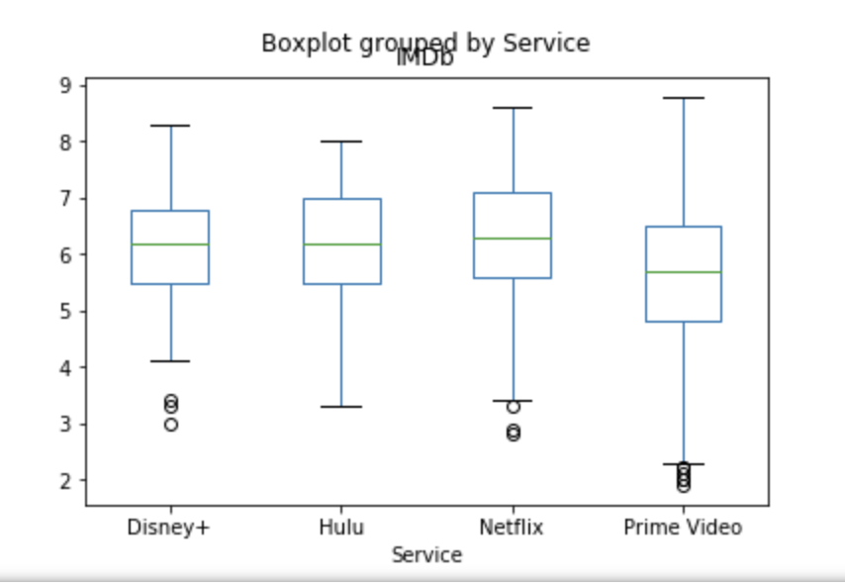
Question:
Which is the best platform for Comedy Movies?
For Comedy Prime has the largest number of movies, but Netflix has the best rating overall

Slide 19

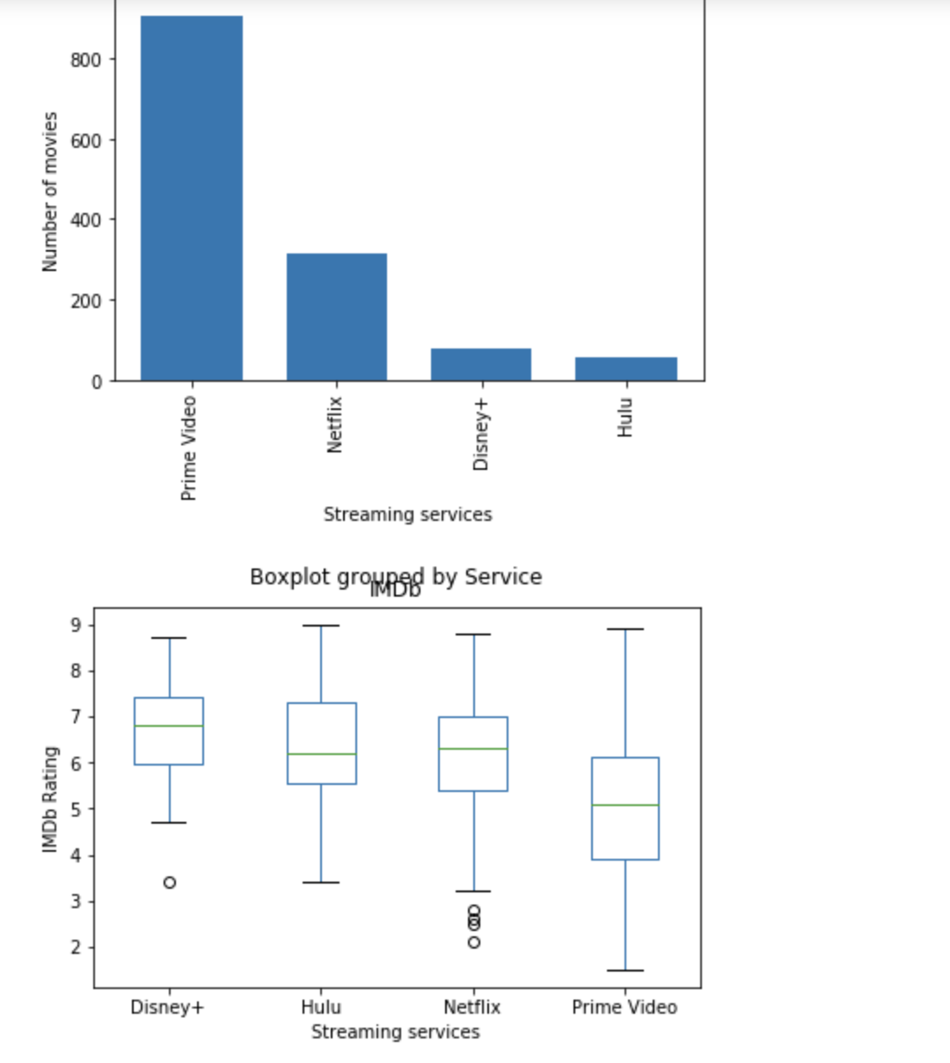
Question:
Which is the best platform for Action Movies?
For Action Prime has the largest number of movies, but Disney + has the best rating overall

Slide 20
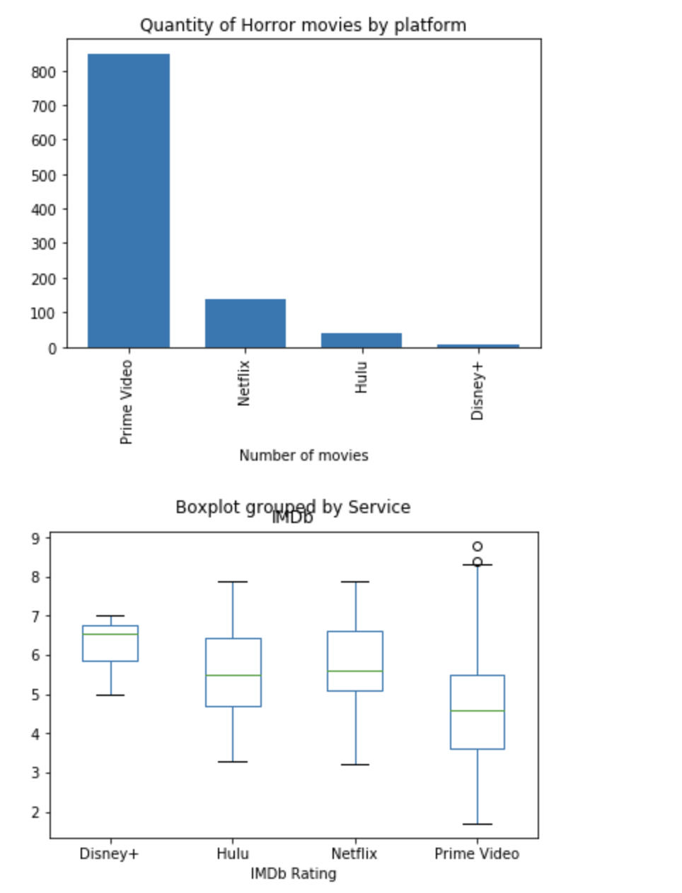

Question:
Which is the best platform for Romance Movies?
For Romance lovers Prime has the largest number of movies, but Disney + has the best rating overall

Slide 21
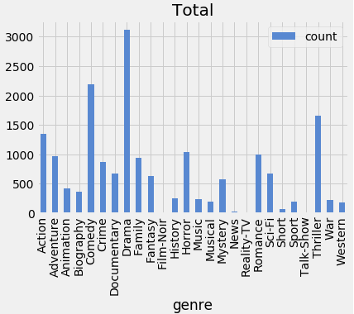

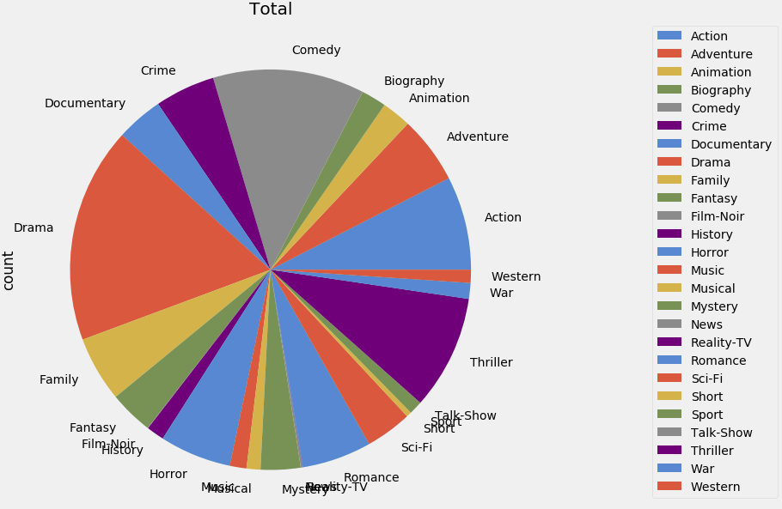

Question: Speaking of unique content...
Genres in Unique content: who has what?
What is the platform with +unique content of your fav genre?
Unique content is homogeneous among almost all platforms, except for Disney +.
The unique content in contrast to regular content represents a high percentage for all but Hulu.

Slide 22
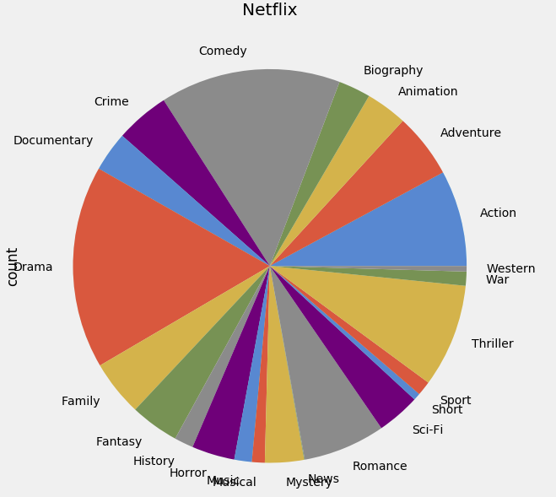
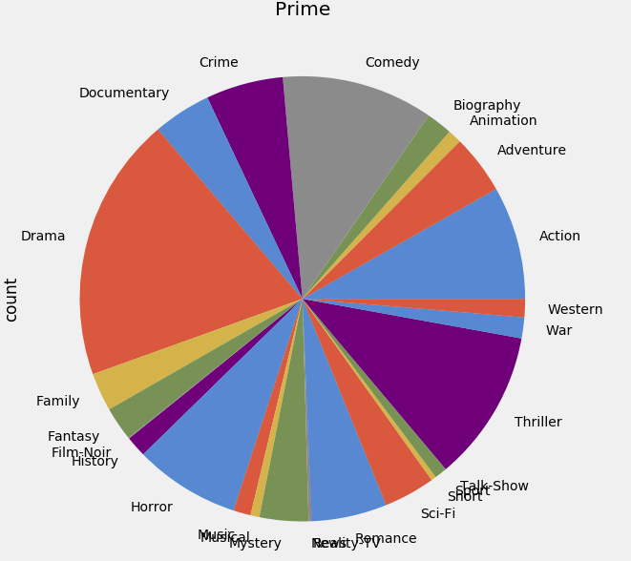
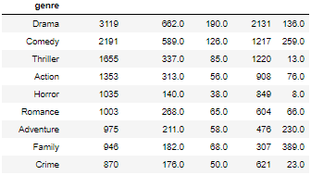
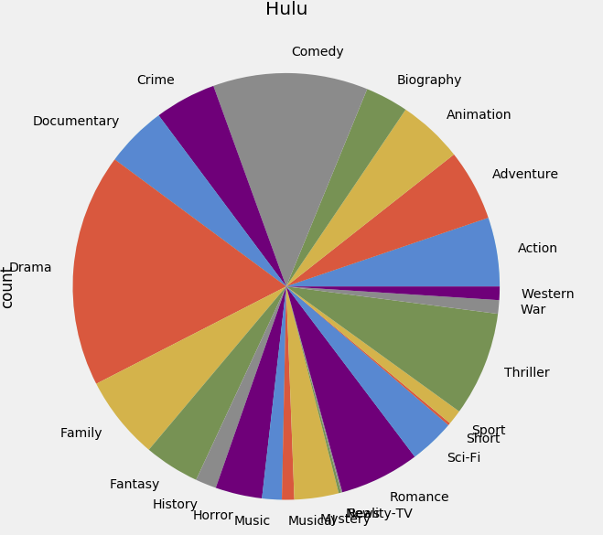
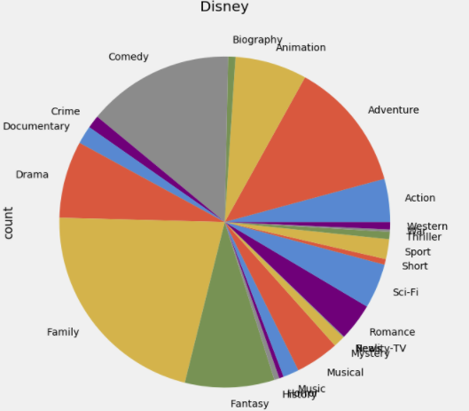
Total Netflix Hulu Prime Disney

Slide 23





Conclusions and Discussion
Netflix:
Get this service if you are looking for new and unique well rated content.
Prime Video:
Get this service if you are looking to have a large selection of movies to choose from.
Hulu:
Get this service if you are looking to have a small selection of well rated content.
Disney+:
Get this service if you are looking for Family-oriented content that has above average rating.
Notes:
We did not expect that Amazon Prime had the largest selection of movies; we believed Netflix would have it.
We did not think that Disney+ would do so well on the IMDb score distributions we did (all of them) . It goes to show that they have mostly good movies on their platform.
We also did not expect that Disney would do so good in the horror genre.
It’s surprising that the top-ranked movie, that we had all the information on, was from Boznia (2013). We expected that the top movie would from the US.
Netflix, Prime Video and Hulu make a special emphasis to have many Drama, Comedy and Romance movies. Only Disney is betting on the Family genre to attract those kinds of customers to their platform.
The fact that Amazon Prime has so many movies, that all differ in quality, ends up affecting how the platform does quality-wise.
Implications:
Hulu is probably not a good service to get...
Prices:
Hulu: $12 USD a month
Prime: $13 USD a month and $119 USD a year
Netflix: $13 USD a month for a Standard Account
Disney+: $7 USD a month and $70 USD a year

Slide 24

Post Mortem:
NO PAIN,
NO GAIN!!
Challenges:
OMDB API:
We tried to use the OMDb API to fill out missing information, but it only helped us fill out the info on 17 movies.
We ended up discarding the use of the API altogether.
Mapping:
Building markers and avoiding marker overlapping. Solutions:
Grouping and looking for first country top rated
Another option is using Overlapping Marker Spiderfier for Google Maps API and Marker Clusterer
https://developer.aliyun.com/mirror/npm/package/overlapping-marker-spiderfier
https://developers.google.com/maps/documentation/javascript/marker-clustering
https://carto.com/blog/stacking-chips-a-map-hack/
Git and GitHub
Further questions:
It will be interesting to continue a further analysis regarding which other attributes determine user’s movie preference and rating assignation
Also, having additional time we were able to create a correlation analysis based on rating, runtime and genre
Because of the data information provided by the Data Base we were not able to prove that:
Users buy streaming services because they dislike commercials
Users select streaming services based on price
Include service prices in some way.

Slide 25

Q&A

